Slide 1



Exploring the Next Generation Digital Learning Environment with Tsugi (次)
Dr. Charles Severance
University of Michigan School of Information
www.tsugi.org

Slide 2
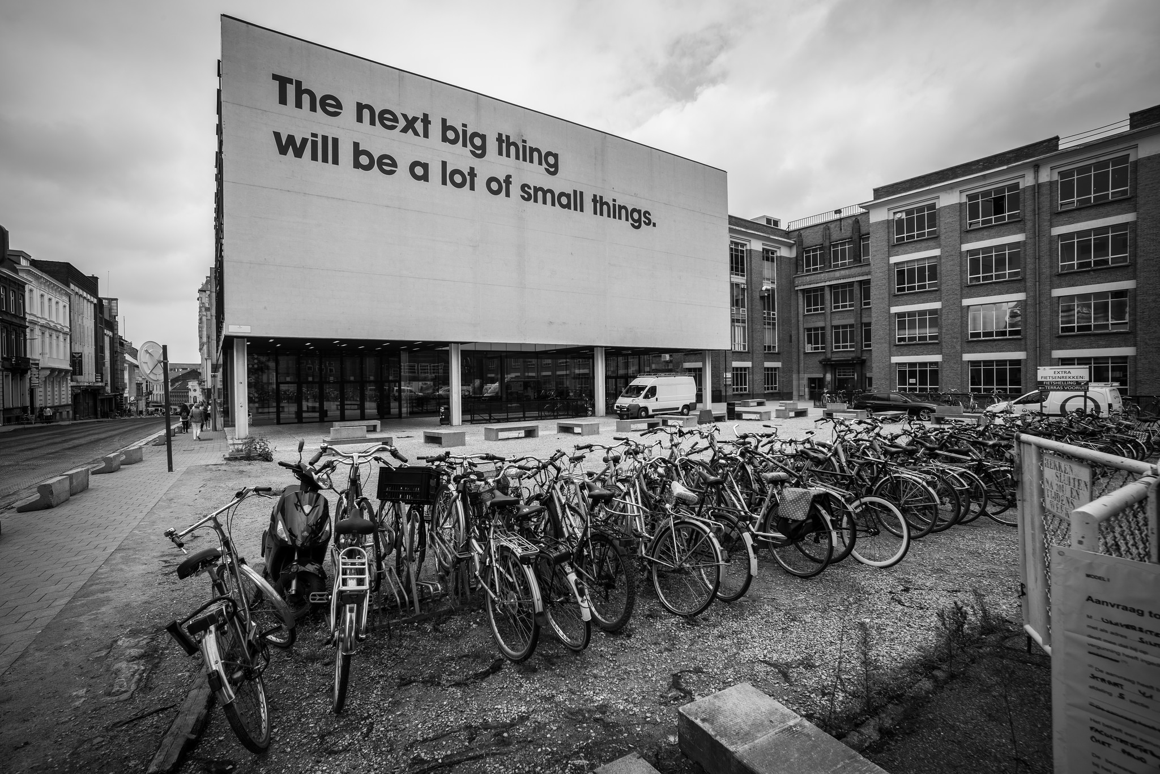
Source: Ian Dolphin

Slide 3
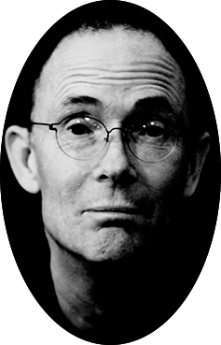
The future is already here — it's just not very evenly distributed.
- William Gibson
https://en.wikiquote.org/wiki/William_Gibson

Slide 4
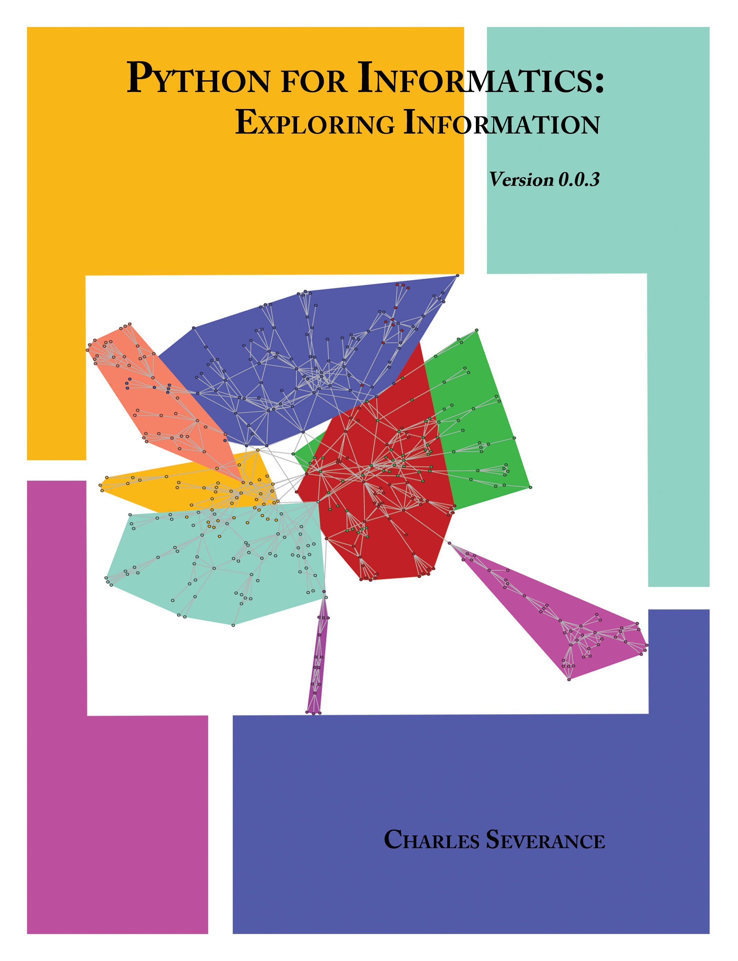
umich.edu
Sakai
Piazza
300
open.umich.edu (drupal)
2
Circa 2012
Notes:
Common Cartridge 2008 / 2011
Learning Tools Interoperability 2011
Content Item 2016

Slide 5

umich.edu
Other Schools / Teachers
Sakai
Moodle
Canvas
Blackboard
Schoology
…
300
15
Sakai
Canvas
1.3M
Coursera
App Store (次)
Apps
EdX
github
3K
Cloudflare
archive.org
py4e.com (次)
Apps
Content
Google Play
Amazon
CreateSpace
iTunes
YouTube
6K
456K
Circa 2016
Notes:
Common Cartridge 2008 / 2011
Learning Tools Interoperability 2011
Content Item 2016

Slide 6
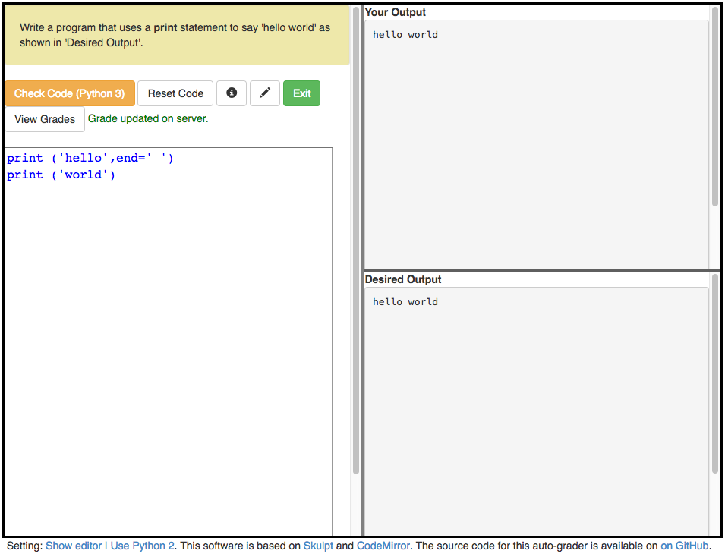
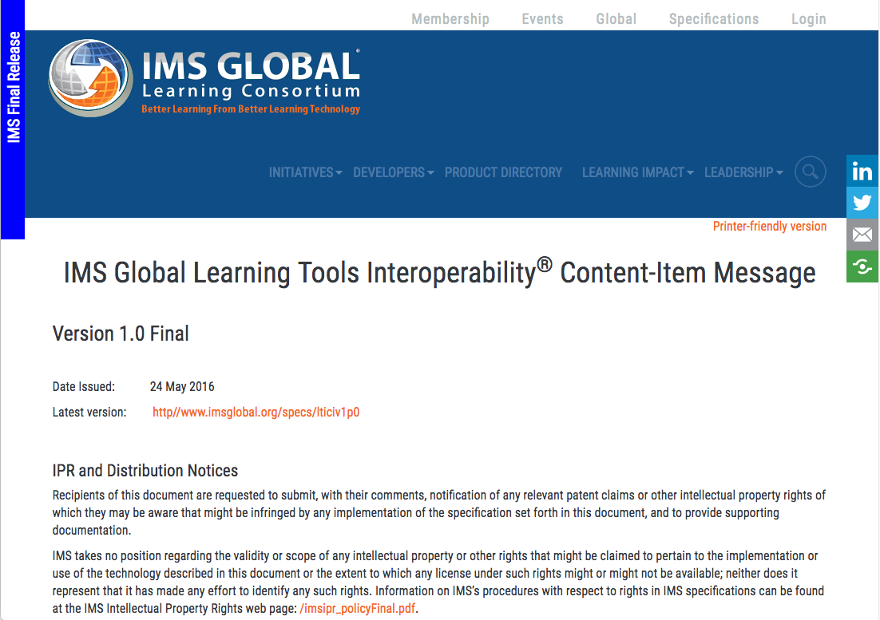
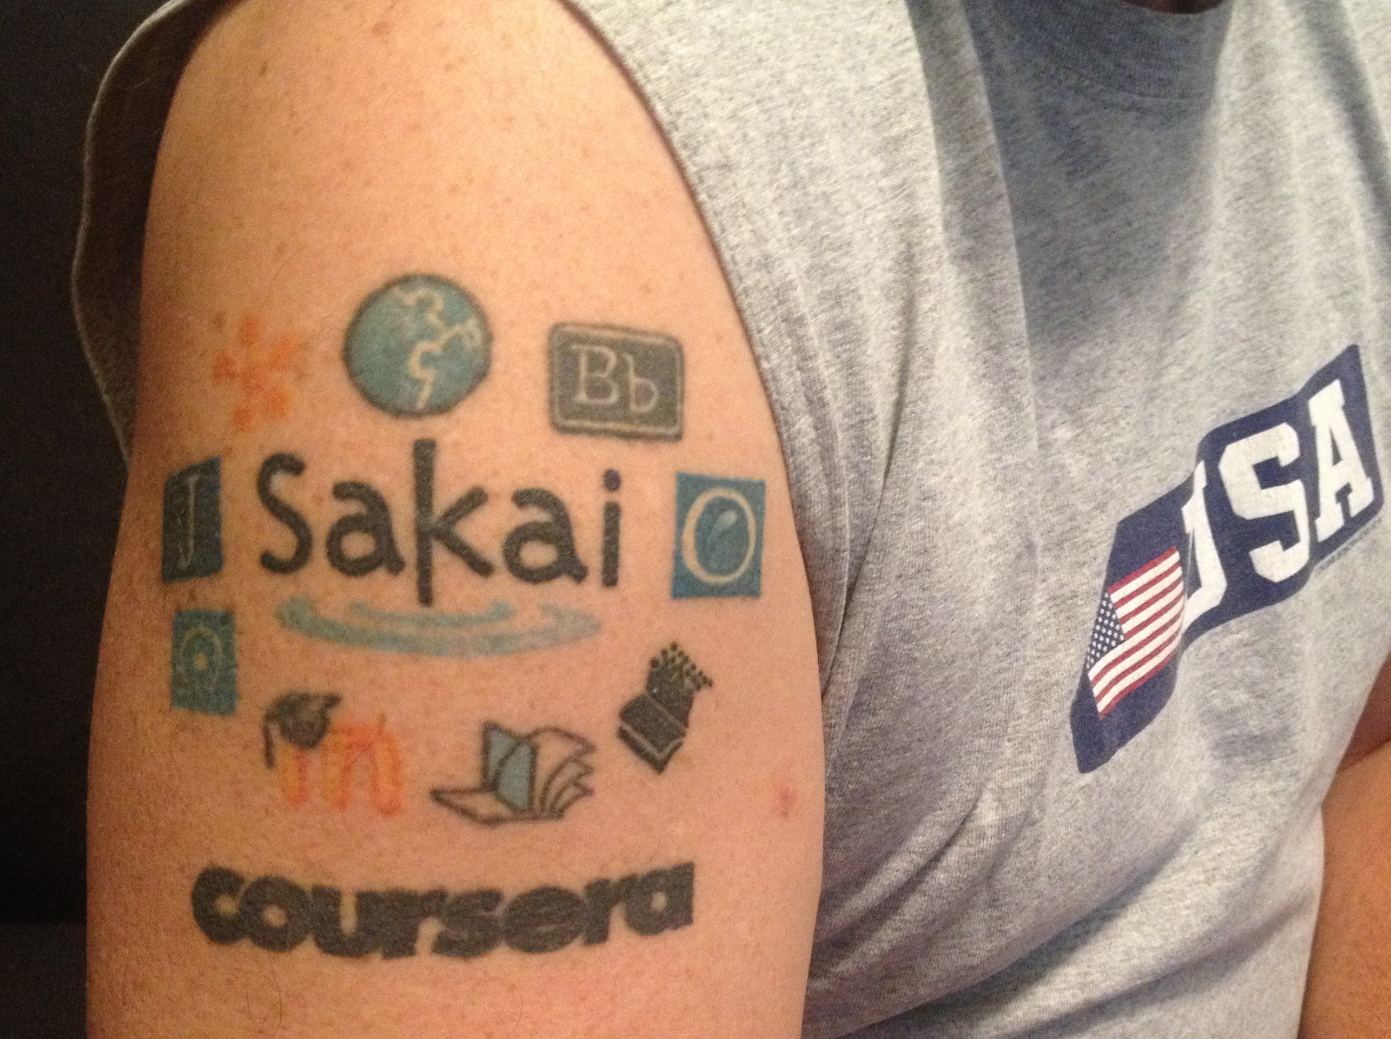
WHAT HAPPENNED?

Slide 7
CONTENT ITEM®
CC®
LTI®
IMS CONTENT ITEM® FILLS THE GAPS AND MAKES CONNECTIONS BETWEEN IMS LEARNING TOOLS INTEROPERABILITY® AND IMS COMMON CARTRIDGE®.
LTI®, CC®, and Content Item® are trademarks of IMS Global Learning Consortium, Inc. (www.imsglobal.org)

Slide 8
CONTENT ITEM®
CC®
LTI®
FOR THE FIRST TIME IN THE HISTORY OF EDUCATIONAL TECHNOLOGY, YOU CAN MAKE AN APP STORE OR LEARNING OBJECT REPOSITORY WITHOUT PROPRIETATY EXTENSIONS.
LTI®, CC®, and Content Item® are trademarks of IMS Global Learning Consortium, Inc. (www.imsglobal.org)

Slide 9
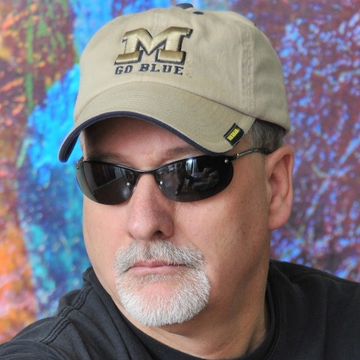
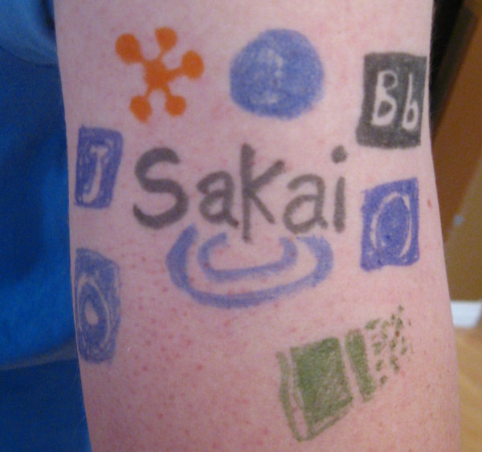
@drchuck
@whitmer
@brackenm

Slide 10
Topics
Educational App Store
API Libraries
"Lego Blocks"
Interoperability
New tools that *teach*
EdTech startups made easy
Training / Documentation
Enrich Open Educational Content
Seamless Content Integration and Reuse (LOR)
Stand-Alone MOOC platform
koseu.org (코스) / moockit.org

Slide 11
Demo

Slide 12
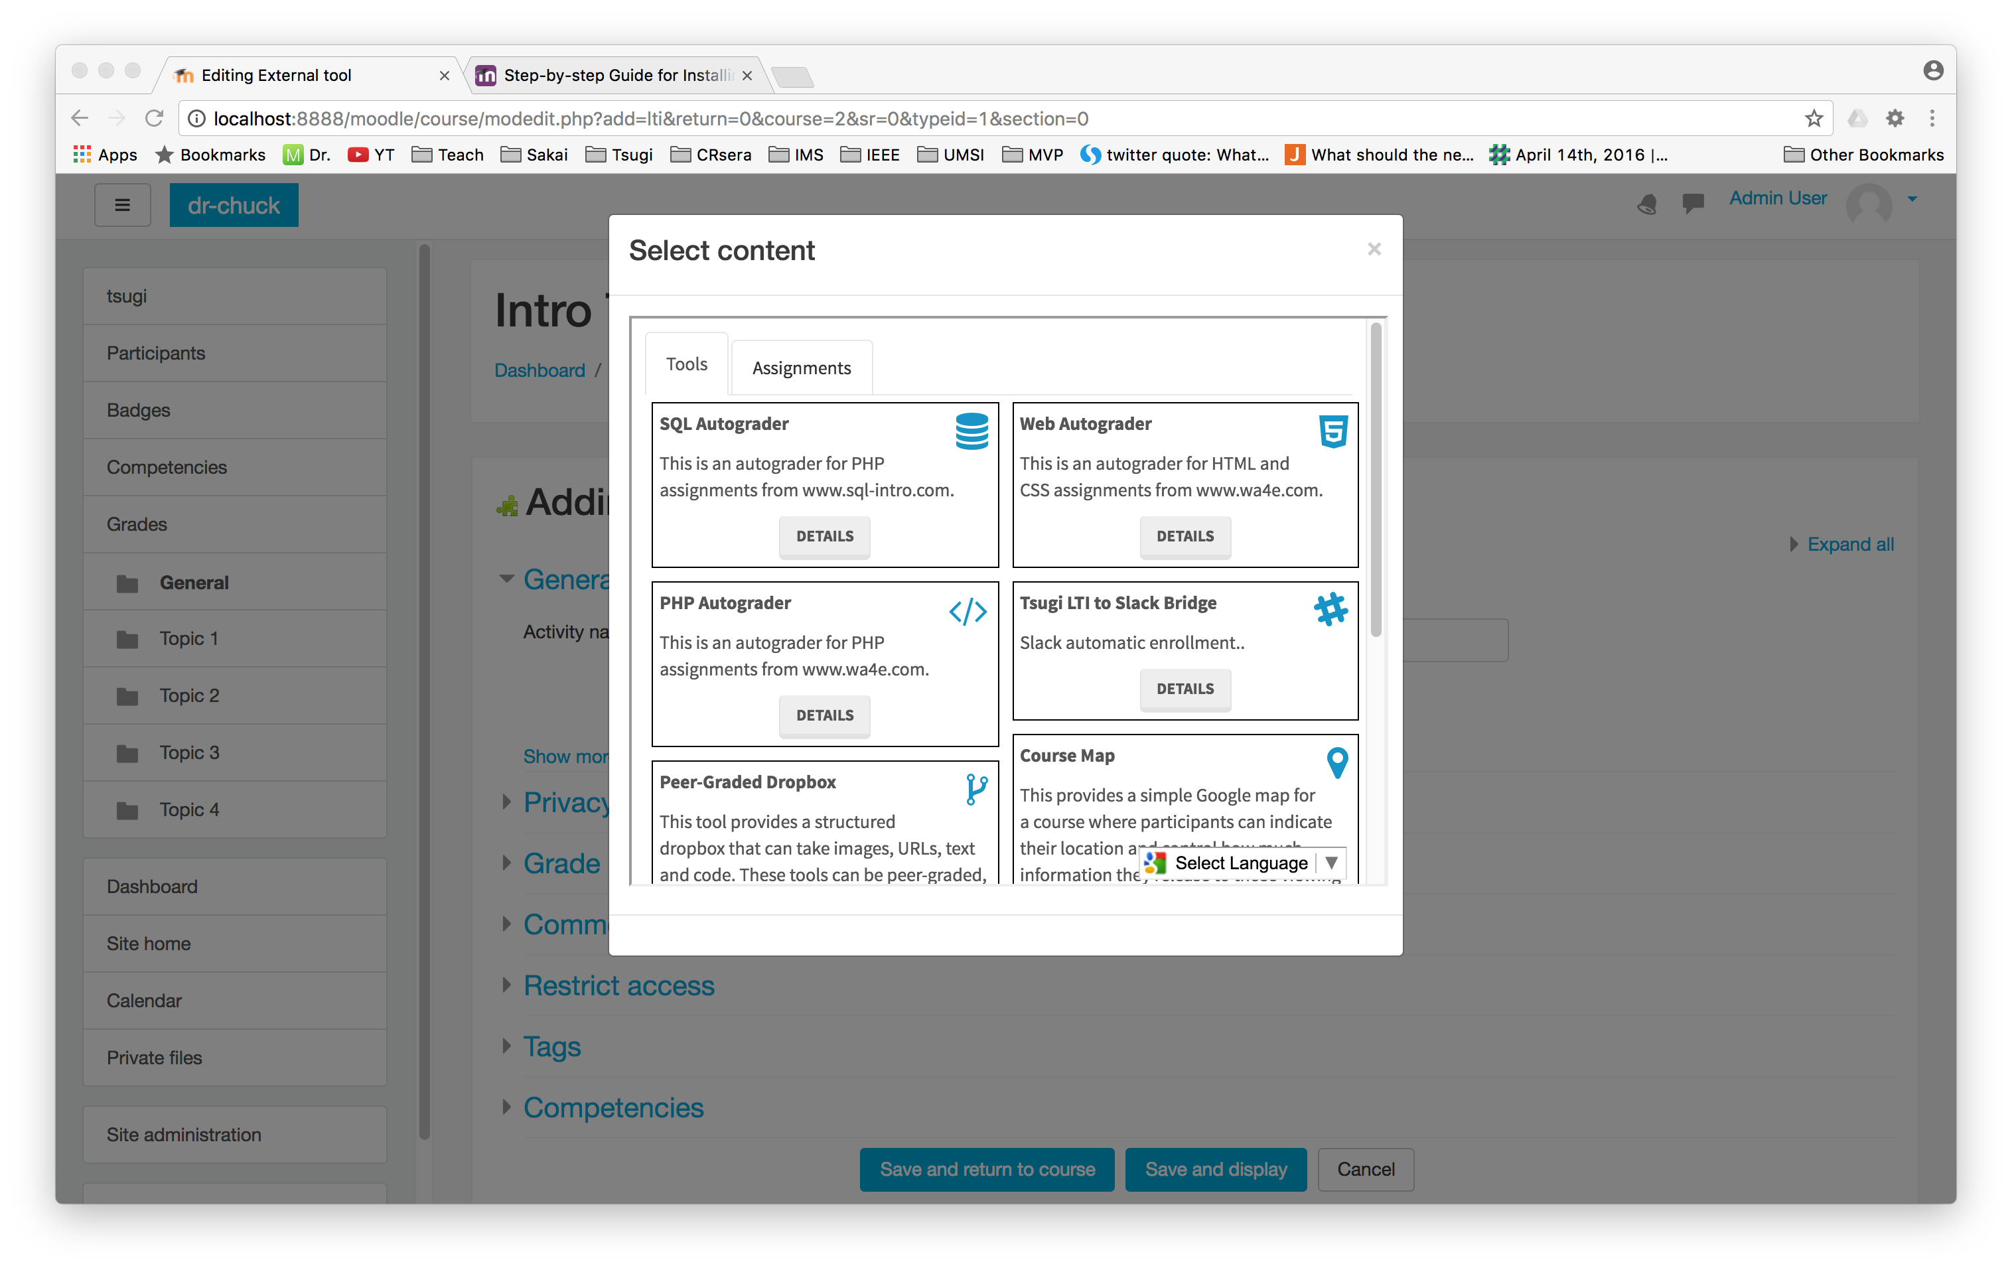

Slide 13
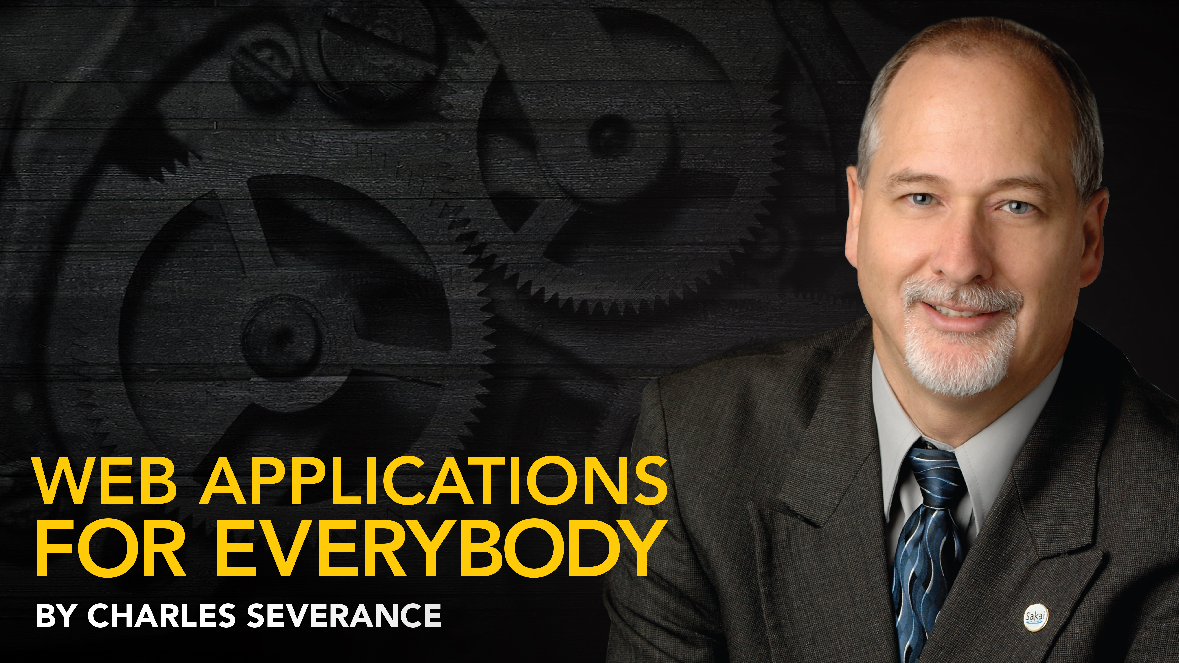
Any Questions? www.tsugi.org www.py4e.com www.wa4e.com

